Slide 1
Functions and requirements of the Data Link Protocols
The basic function of the layer is to transmit frames over a physical communication link. Transmission may be half duplex or full duplex. To ensure that frames are delivered free of errors to the destination station a number of requirements are placed on a data link protocol. The protocol (control mechanism) should be capable of performing:
The identification of a frame (i.e. recognize the first and last bits of a frame).
The transmission of frames of any length up to a given maximum. Any bit pattern is permitted in a frame.
The detection of transmission errors.
The retransmission of frames that were damaged by errors.
The assurance that no frames were lost.
In a multidrop configuration -> Some mechanism must be used for preventing conflicts caused by simultaneous transmission by many stations.
The detection of failure or abnormal situations for control and monitoring purposes.

Slide 2
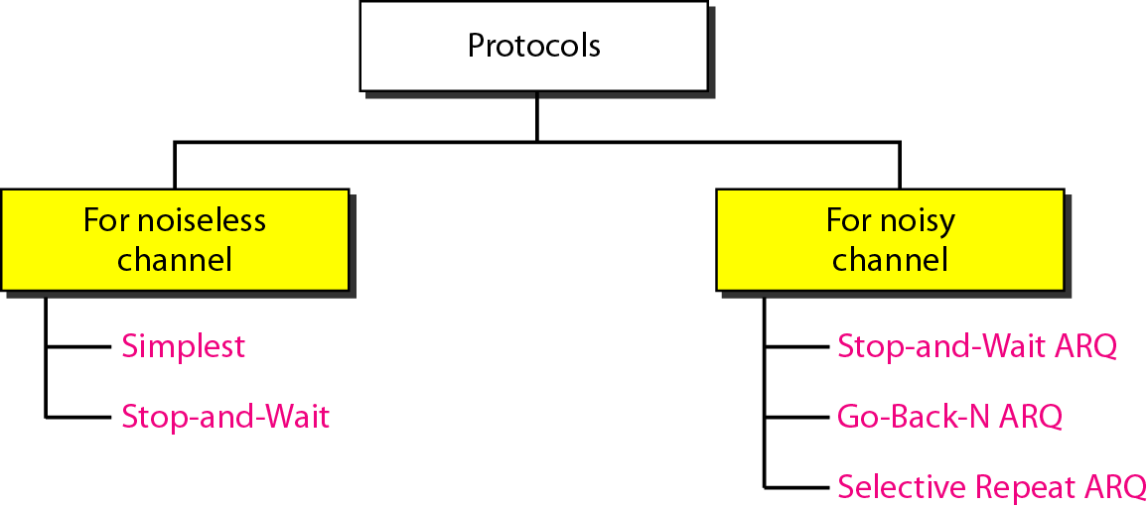
Elementary Data Link Protocols
The protocols are normally implemented in software by using one of the common programming languages.
An Unrestricted Simplex Protocol
A Simplex Stop-and-Wait Protocol
A Simplex Protocol for a Noisy Channel

Slide 3
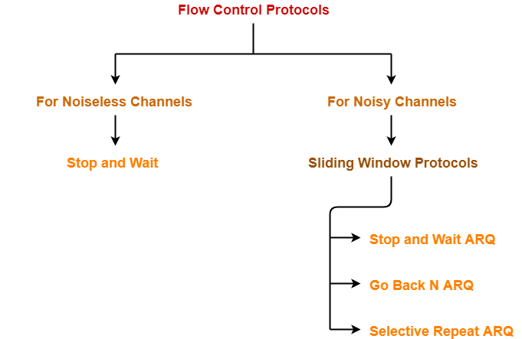

Slide 4
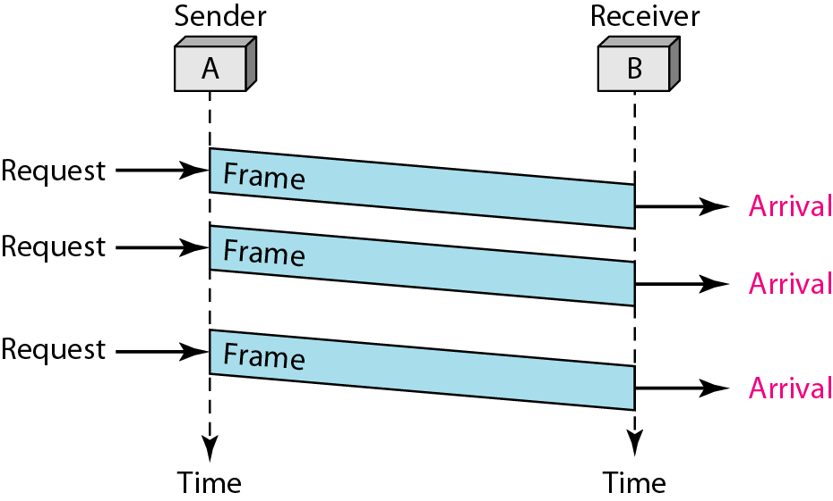
An unrestricted simplex protocol
Simple but unrealistic protocol.
Data are transmitted in one direction only. (Uni-directional)
The transmitting (Tx) and receiving (Rx) hosts are always ready
Processing time can be ignored.
Infinite buffer space is available.
No errors occur; i.e. no damaged frames and no lost frames (perfect channel)

Slide 6
A simplex stop-and-wait protocol
In this protocol we assume that Data are transmitted in one direction only
No errors occur (perfect channel)
The receiver can only process the received information at a finite rate
These assumptions imply that the transmitter cannot send frames at a rate faster than the receiver can process them.
The problem here is how to prevent the sender from flooding the receiver.
A general solution to this problem is to have the receiver provide some sort of feedback to the sender. The process could be as follows: The receiver send an acknowledge frame back to the sender telling the sender that the last received frame has been processed and passed to the host; permission to send the next frame is granted. The sender, after having sent a frame, must wait for the acknowledge frame from the receiver before sending another frame.
This protocol is known as stop-and-wait.

Slide 7
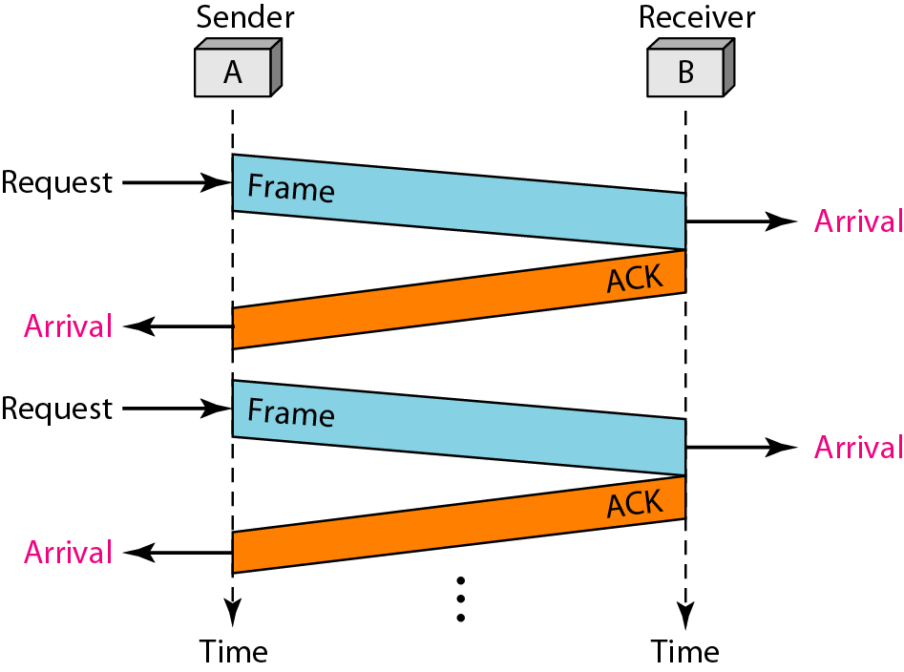
Stop & Wait Protocol
The sender sends one frame and waits for feedback from the receiver. When the ACK arrives, the sender sends the next frame

Slide 10
Flow Control Mechanisms
Stop-and-Wait(Rules)
SENDER SIDE
Rule1: Send single Frame at a time
Rule2: Send next Frame after receiving ACK
Receiver Side
Rule1: Receive and store the frame
Rule2: Send ACK to sender after storing

Slide 11
Flow Control Mechanisms
Stop-and-Wait
Working
The working of a stop and wait protocol may be explained as-
Sender sends a data packet to the receiver.
Sender stops and waits for the acknowledgement for the sent packet from the receiver.
Receiver receives and processes the data packet.
Receiver sends an acknowledgement to the sender.
After receiving the acknowledgement, sender sends the next data packet to the receiver.

Slide 12
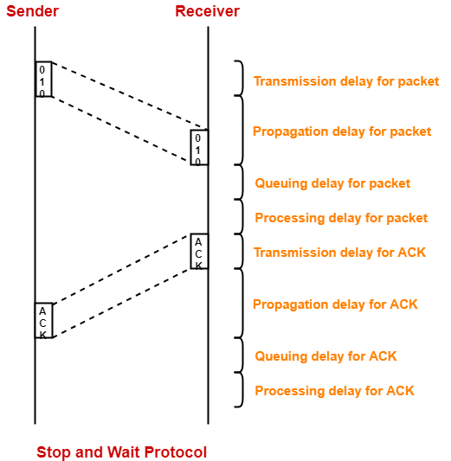
Flow Control Mechanisms
Stop-and-Wait

Slide 13
Flow Control Mechanisms
Stop-and-Wait
Total time taken in sending one data packet
= (Transmission delay + Propagation delay + Queuing delay + Processing delay)_{packet}
+
(Transmission delay + Propagation delay + Queuing delay + Processing delay)_{ACK}
Assume
Queuing delay and processing delay to be zero at both sender and receiver side.
Transmission time for the acknowledgement to be zero since it’s size is very small.
Under the above assumptions.
Total time taken in sending one data packet = (Transmission delay + Propagation delay)_{packet} + (Propagation delay)_{ACK}

Slide 14
Flow Control Mechanisms
Stop-and-Wait
We know,
Propagation delay depends on the distance and speed.
So, it would be same for both data packet and acknowledgement.
So, we have-
Total time taken in sending one data packet = (Transmission delay)_{packet} + 2 x Propagation delay

Slide 15
Flow Control Mechanisms
Efficiency
Efficiency of any flow control protocol is given by-
where-
Useful time = Transmission delay of data packet = (Transmission delay)_{packet}
Useless time = Time for which sender is forced to wait and do nothing = 2 x Propagation delay
Total time = Useful time + Useless time
Efficiency (η) = Useful Time / Total Time

Slide 16
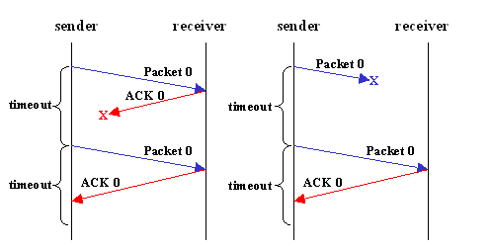
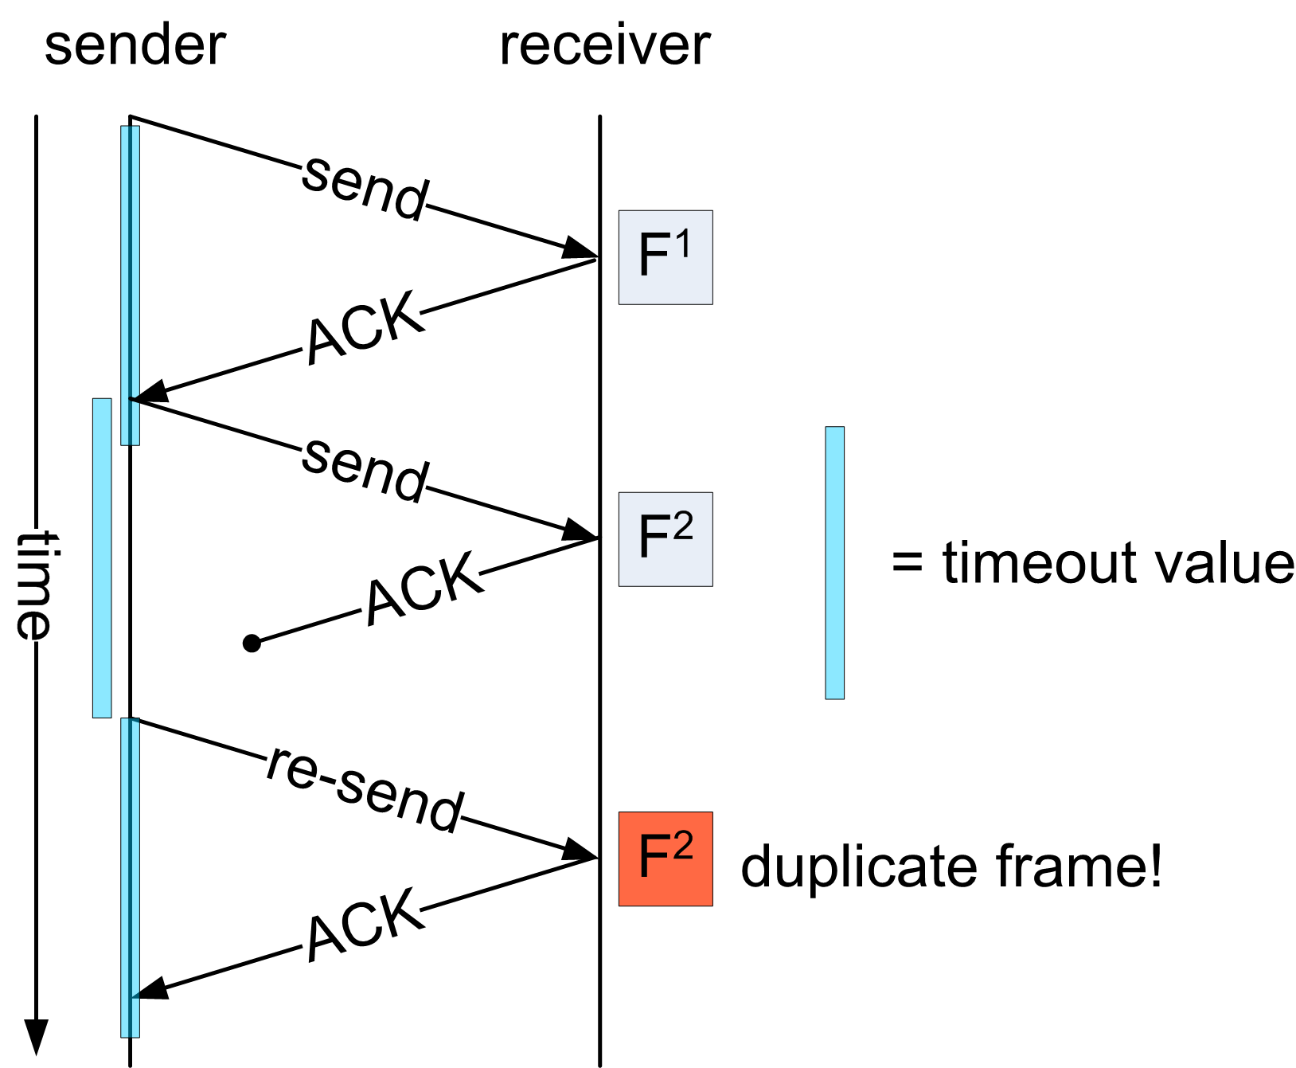
A simplex protocol for a noisy channel
Frames may be either damaged or lost completely. We assume that transmission errors in the frame are detected by the hardware checksum. One suggestion is that the sender would send a frame, the receiver would send an ACK frame only if the frame is received correctly. If the frame is in error the receiver simply ignores it; the transmitter would time out and would retransmit it.
One problem with the above scheme is that if the ACK frame is lost or damaged, duplicate frames are accepted at the receiver without the receiver knowing it.

Slide 17
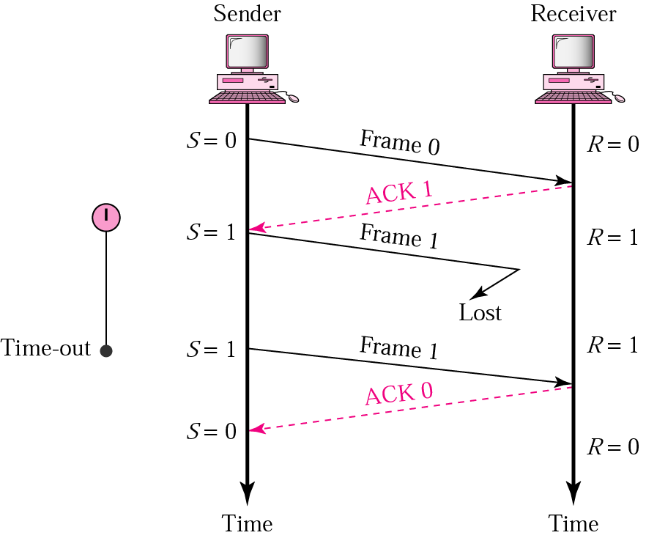
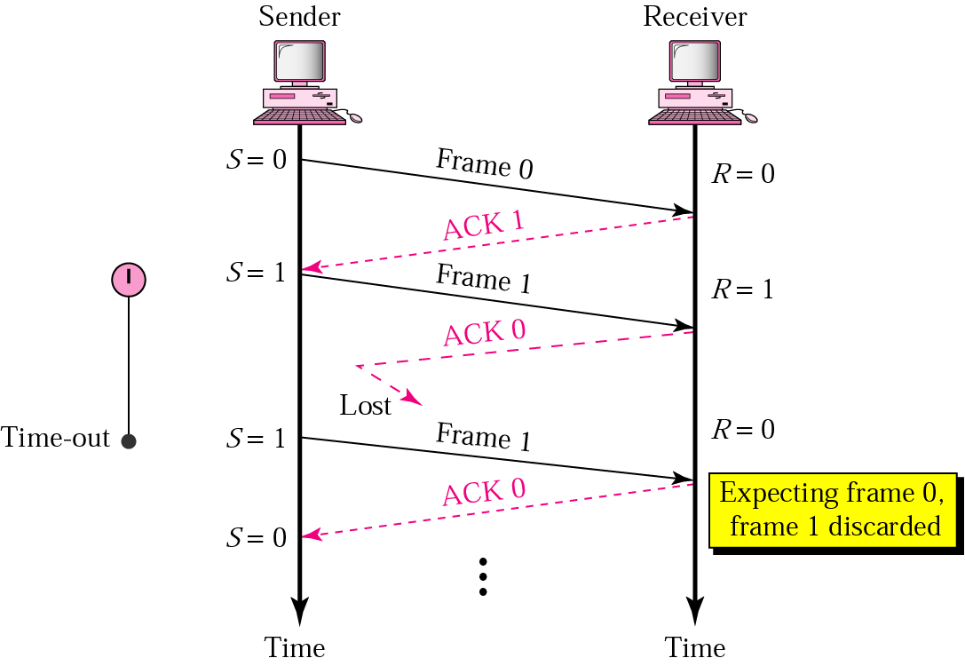
Stop-and-Wait, lost ACK frame
Imagine a situation where the receiver has just sent an ACK frame back to the sender saying that it correctly received and already passed a frame to its host. However, the ACK frame gets lost completely, the sender times out and retransmits the frame. There is no way for the receiver to tell whether this frame is a retransmitted frame or a new frame, so the receiver accepts this duplicate happily and transfers it to the host. The protocol thus fails in this aspect.
Stop-and-Wait, lost frame

Slide 18
To overcome this problem it is required that the receiver be able to distinguish a frame that it is seeing for the first time from a retransmission. One way to achieve this is to have the sender put a sequence number in the header of each frame it sends. The receiver then can check the sequence number of each arriving frame to see if it is a new frame or a duplicate to be discarded.
The receiver needs to distinguish only 2 possibilities: a new frame or a duplicate; a 1-bit sequence number is sufficient. At any instant the receiver expects a particular sequence number. Any wrong sequence numbered frame arriving at the receiver is rejected as a duplicate. A correctly numbered frame arriving at the receiver is accepted, passed to the host, and the expected sequence number is incremented by 1 (modulo 2).

Slide 19
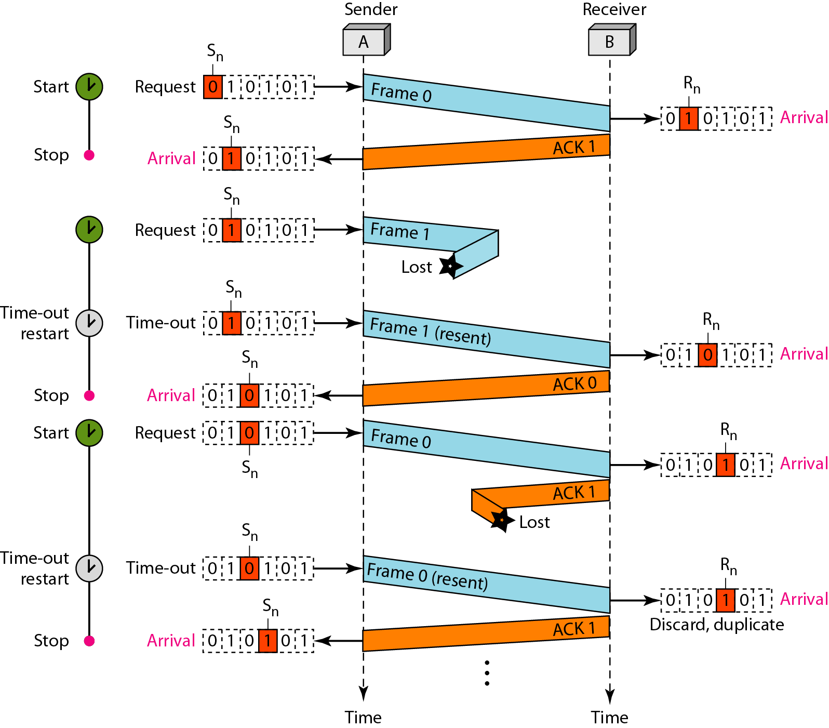
Flow Diagram of a Stop & Wait Protocol

Slide 20
After transmitting a frame and starting the timer, the sender waits for something exciting to happen.
Only three possibilities exist: an acknowledgement frame arrives undamaged, a damaged acknowledgement frame staggers in, or the timer expires.
If a valid acknowledgement comes in, the sender fetches the next packet from its network layer and puts it in the buffer, overwriting the previous packet. It also advances the sequence number. If a damaged frame arrives or no frame at all arrives, neither the buffer nor the sequence number is changed so that a duplicate can be sent.
When a valid frame arrives at the receiver, its sequence number is checked to see if it is a duplicate. If not, it is accepted, passed to the network layer, and an acknowledgement is generated. Duplicates and damaged frames are not passed to the network layer.

